Slide 1
Andover R&D Center
700+ employees 236K sq. ft of space 39 labs
$14 million SE equipment
19,000 Visitors each year

Slide 2
Andover is 1of 5 Schneider Electric Global Design Centers
Grenoble, France
Andover, USA
Shanghai, China
Bangalore, India
Monterrey, Mexico

Slide 3
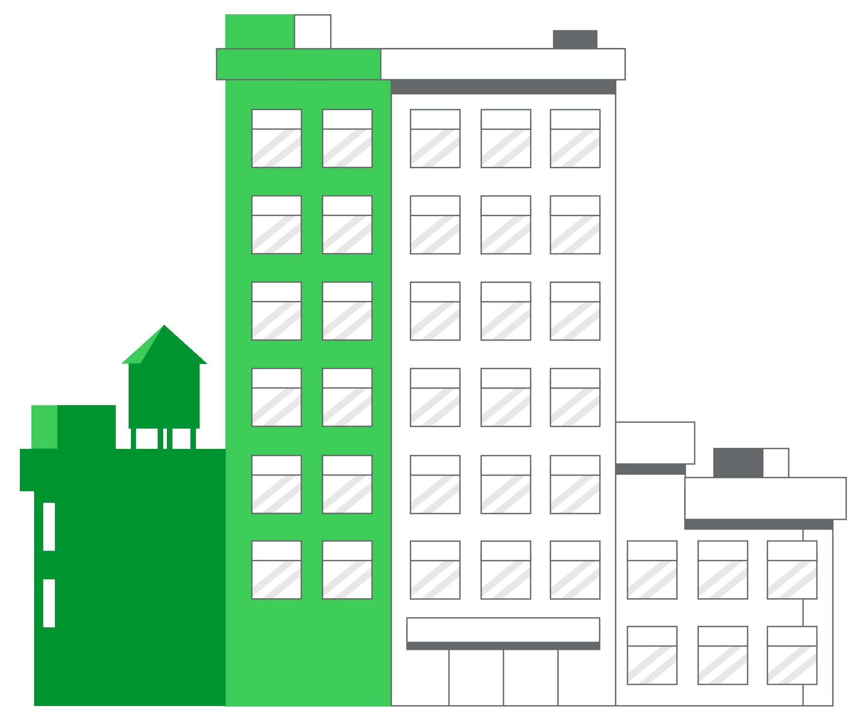
Schneider Electric, Andover R&D Center
Situation
Consolidated over 400,000 sq. ft of space across 3.5 buildings/locations
Modernize a 236,000 sq. ft building to be 1 of 5 Global R&D Centers
The Solution
Installed and integrated SE solutions: 3 Data Centers, Building Management System, Security, Access Control, Energy monitoring, Video Surveillance, and Workplace Management
Microgrid consisting of 1300 solar panels, generator and battery backup system to island over 25,000 sq. ft of space (800 Kw)
20 EV Charging Stations
Results
27% reduction in energy from consolidating locations
Additional 35% energy savings from SE products & services, Microgrid, & renegotiated utility terms
Using 100% renewable electric energy
Notes:
ISO 50001 Certified
IOT EcoStruxure @ BOC Video: https://www.youtube.com/watch?v=DDi8I9IXg-U
Benefits:
Modern and comfortable work environment
Highly secure workplace
Greater efficiency and collaboration on how employees work within 41 R&D Labs
State-of-the-art amenities including charging stations, wellness programs, training center, conference center, cafeteria and fitness center

Slide 4
Schneider Electric, Andover R&D Center
EcoStruxure Offers installed at Andover R&D Center, USA
Apps, analytics,
and services
Building Advisor, Resource Advisor, Asset Advisor IT, Workplace Advisor, MicroGrid Advisor, Engage Enterprise
Edge control
Power Monitoring Expert, Data Center Expert, EcoStruxure Building Operation, Security Expert, Video Expert, Microgrid Operation
Over 1,800 Connected products with an excess of 4,300 connected points
Server room In Row Colling, EcoBreeze, Eco Isle, Racks, Data Center UPS, Symmetra PX-PDU’s, PC & Server UPS, Bus Controls, NetBotz Wireless Temperature Sensors, Battery Monitoring / Battery Energy Storage Solution
HVAC Control – Automation Servers, BACnet Field Controllers (b3) for Heat Pump, VAV and CAV control, SE7xxx Room Controllers, integration via BACnet to Chiller, Energy Recovery & Ventilation, Altivar 212 VSD for HVAC
Lighting, Motion, and CO2 Sensors, Access Control System, PIBCV valves.
Switchgear, Power Meters, Building Entrance Surge protection, Panel Boards & Breakers
Energy Control Center, M580 PLC, Magelis touch screen HMI, SurgeLogic surge protection devices
EcoStruxure Web Services for Power, HVAC and Data Center
IOT sensors monitoring building and occupant wellness (Temp, CO2, Noise, Light Level, VOCs, Occupancy)
Connected
products
Notes:
4,237 connected points using 1,833 SE Devices

Slide 5
Facts about the Labs

Slide 6
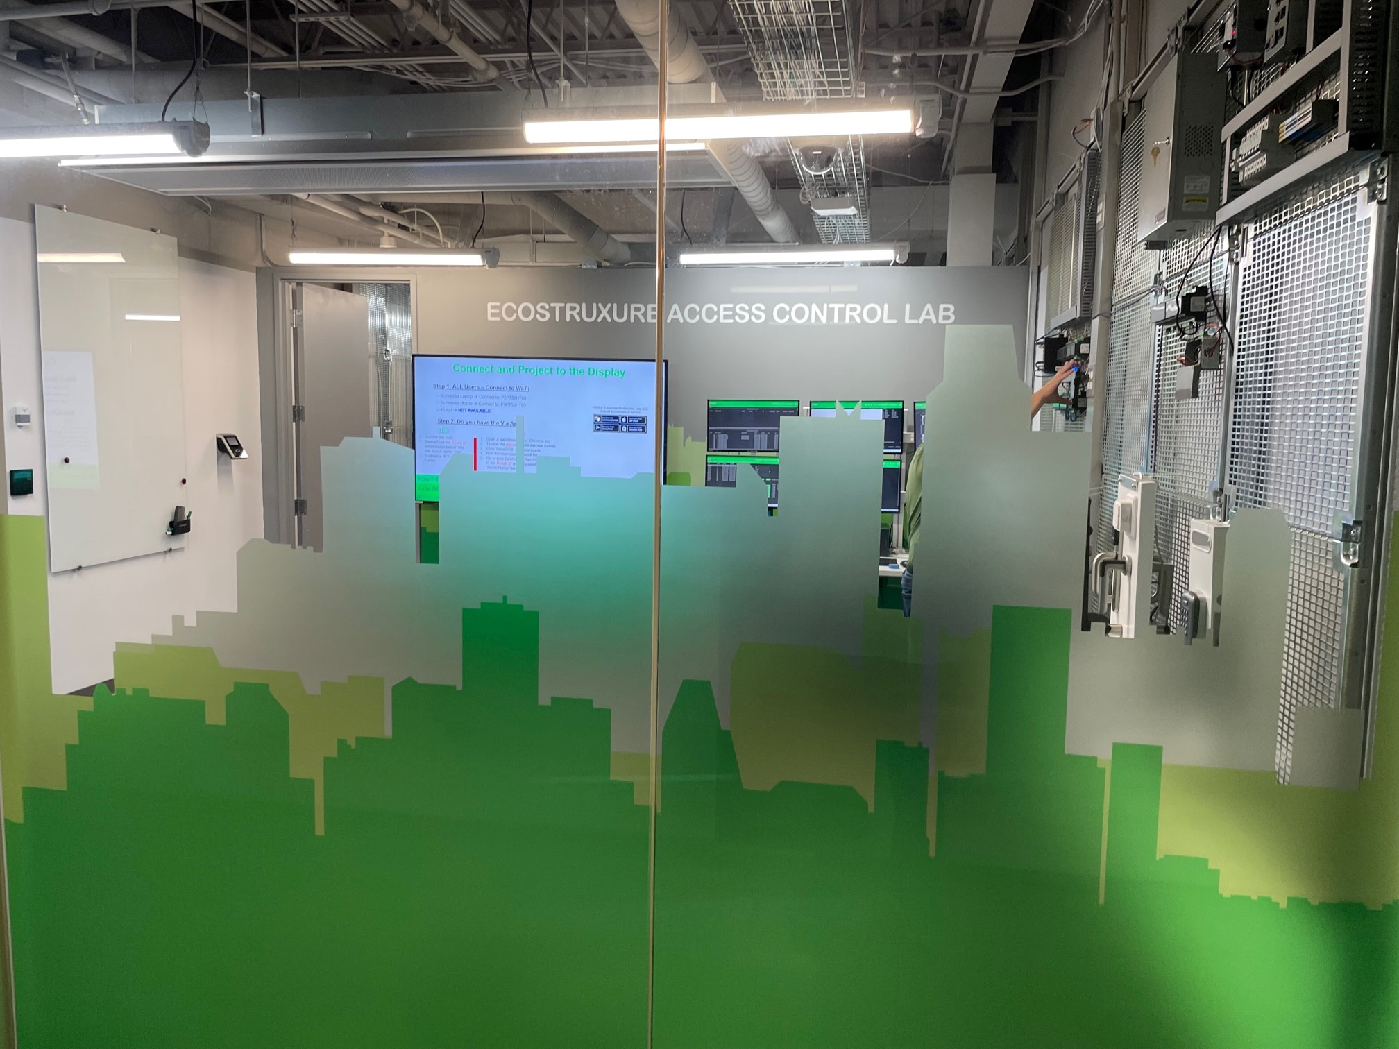
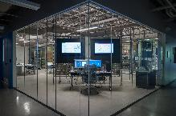
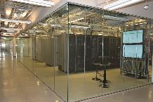
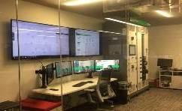
Overview of the Labs
53K Square feet of Labs
39 Labs in total
These can be categorized as;-
5 Customer facing Labs (1C)
28 R&D Labs
6 Hardware Labs
3 Software Labs
19 Test Labs
3 Customer Care and Tech Support Labs
1 Design & Ergonomics Lab (2W)
1 Internal Support Lab (IT)
1 Cyber Security (3C)
Customer Facing Labs
EcoStruxure Building Solutions
Access Control Lab
Network Competency
Data Center Infrastruxure
Microgrid

Slide 7
Enhance Visit with a Facility Tour: 45-60 Minutes
Andover Site Data Center
Andover’s own DC for IT infrastructure, EcoBreeze, Eco Isle, configurable UPS, metering
Access Control Lab Our EcoStruxure Access Control Lab is a testing and validation lab for Schneider Electric’s Physical Access Control and Intrusion systems. Our team tests our Access Control offer releases, transitions from legacy access control offers and validates our extensive integrations with these products.
The lab has a customer facing Demo space, where we can demonstrate many of the systems capabilities as well as integrations with EBO, Biometric readers, wireless locks, intrusion detection, video monitoring, reporting, legacy transitions and more.
EcoStruxure Building Solutions Lab
Experts on Buildings, Integration, BMS, Applications, and IT Networking (Healthcare demo, CRS Demo, EcoStruxure @ Work Demo); also a Hotel Demo room
Network Competency Lab
Industrial automation BU - Test process controls for Industrial Ethernet network architectures, robustness, and security
Hotel Room Experience the Connected Room Solution (CRS) for hotels
Reception
Meet visitor, review safety, Andover R&D site facts
The VIEW (Welcome Café)
JPT welcome video, intro EcoStruxure, SE segments/solutions, customer success videos, ON Button
EcoStruxure Energy Wall
Showcase live Building Data on SE Software/Apps – Resource Advisor, Microgrid Advisor, Power Monitoring Expert, EcoStruxure Building Operation
Innovation & Community Leaders Wall
Edison experts and volunteer community leaders
EcoStruxure Building Solutions Lab Data Center
Server room for Building's lab and Interoperability lab – secure power products, in-row cooling, etc.
Microgrid Lab (& Facebook Lab)
EcoStruxure Architecture provides the full Microgrid solution – simulating outage with ECC and Microgrid Advisor (mention Facebook lab/area)
Data Center Infrastruxure Lab
Example of real-world data center, tests and validates all SE DC solutions
Battery Backup Storage System (BESS) located in DC Lab
Used to power the Microgrid in an outage
ADDITIONAL STOPS
Fitness Center - SE / Andover Wellness focused
Cafeteria - Wellness focused, ability for meeting area tied to conference center
Training Center - SE products/solutions for customers and partners
Conference Center - State-of-the-art facility, multi-function space

Slide 8
Enhance Visit Experience
Tour any one of the following labs
EcoStruxure Building Solutions Lab: To experience the depth and breadth of EcoStruxure Building Operation, customers can learn from subject matter experts and see the newest innovations in buildings, integrations, BMS and solutions. Healthcare and hospitality demos available.
Network Competency Lab: Industrial Automation business unit focused on Industrial Ethernet network architectures, robustness, and security for high-speed applications.
Microgrid Lab: See how the EcoStruxure Architecture works together – simulating an outage and showing real-time data using the Energy Control Center (ECC) and EcoStruxure Microgrid Advisor (EMA).
Data Center Infrastruxure Lab: A giant sand box for testing and learning about how our SE data center products interoperate with other SE products and third party products.
Hotel Lab: Experience the Connected Room Solution (CRS) for hotels. Guests will learn from segment experts about the latest technologies and innovations showcased in this luxurious guest suite
Customer Facing Labs
EcoStruxure Building Solutions
Microgrid
Network Competency
Data Center Infrastruxure

Slide 9
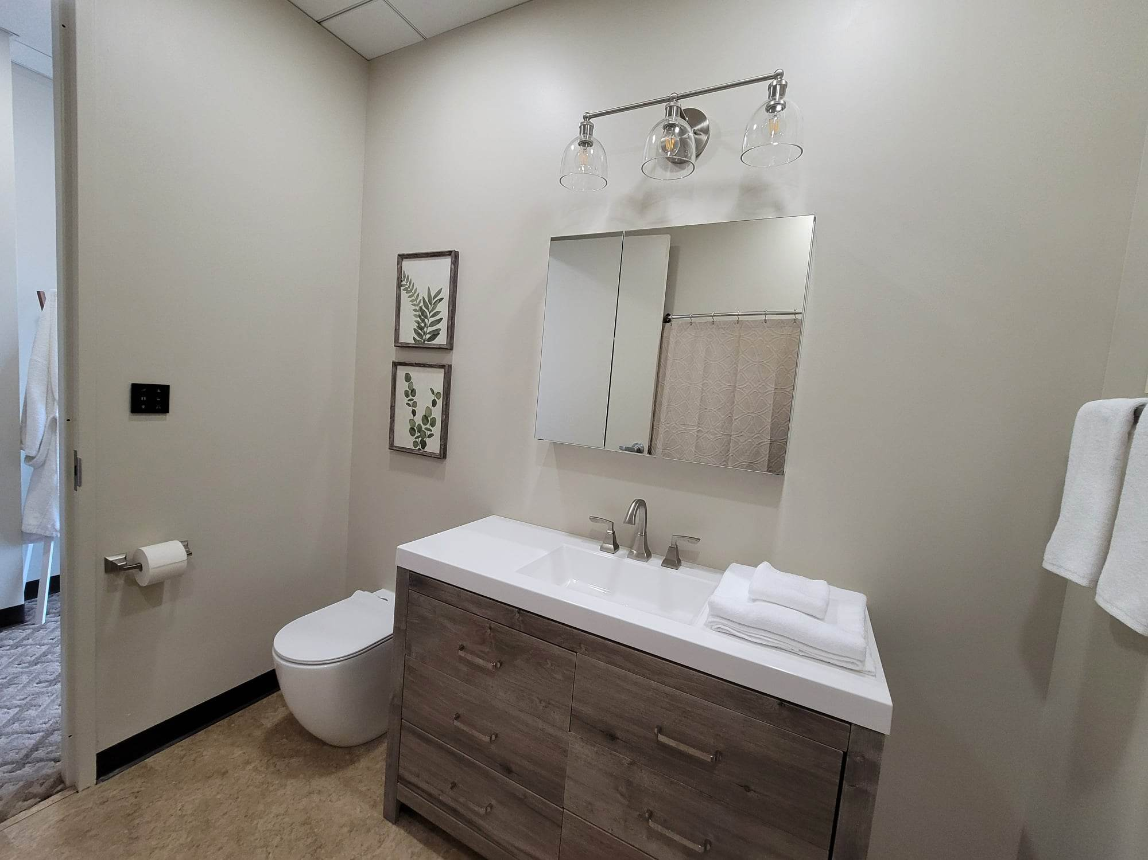
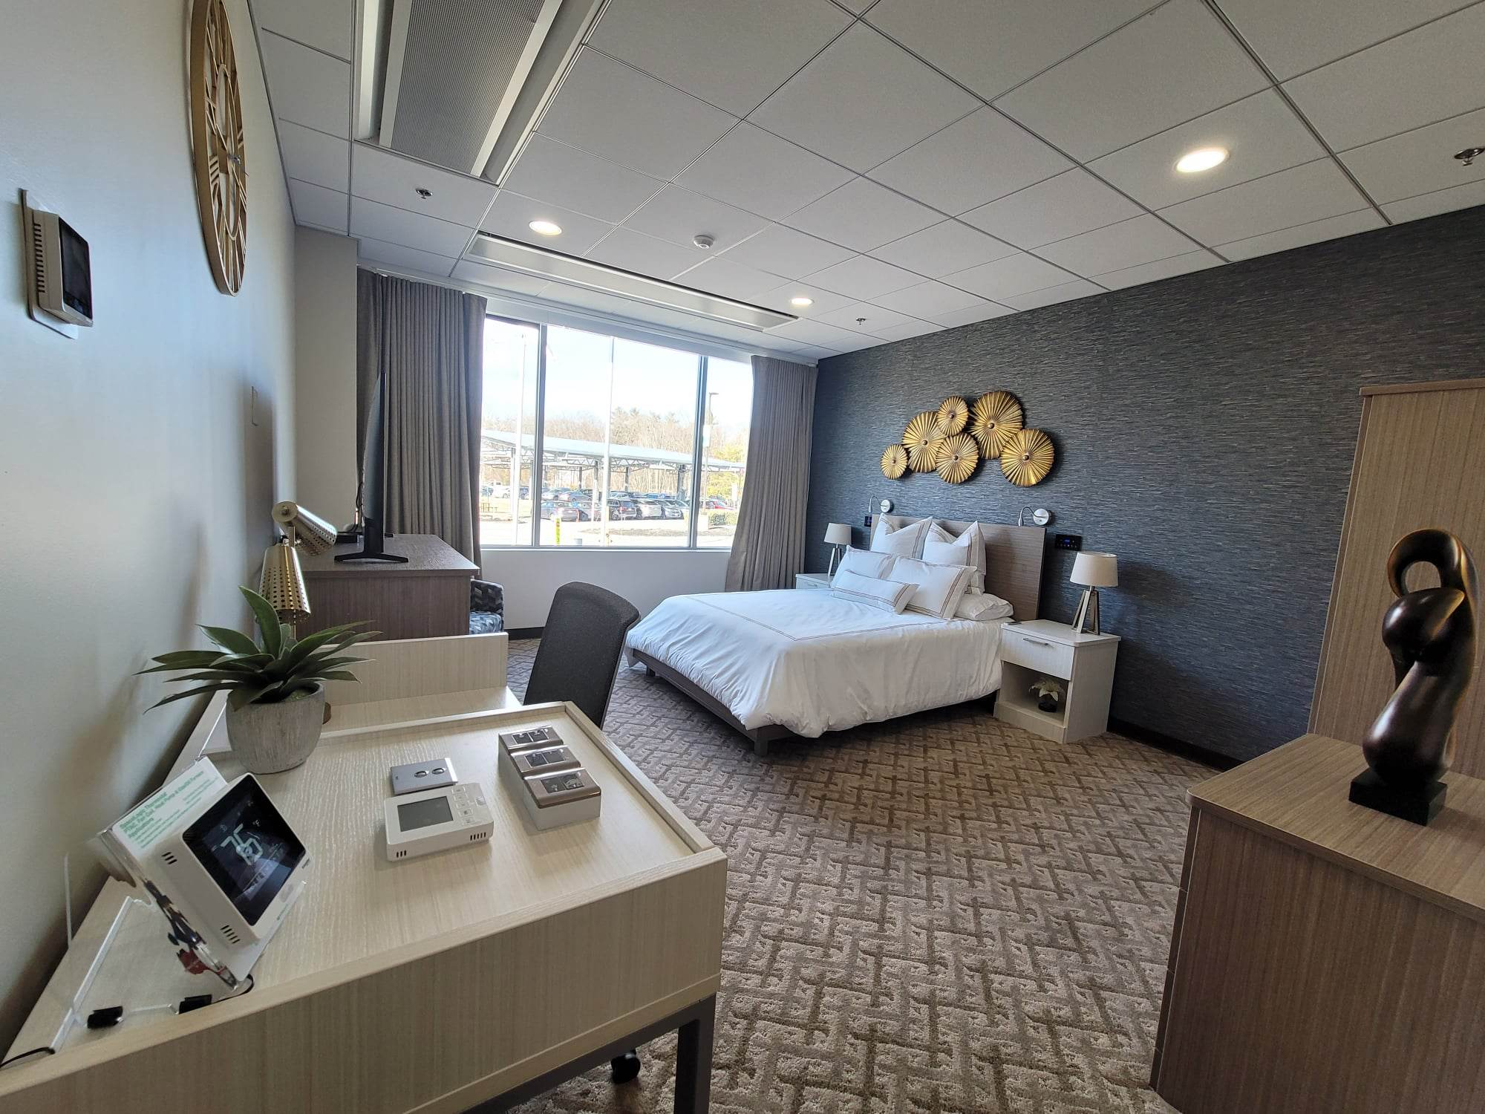
Enhance Visit Experience - continued
Hotel Lab: Experience the Connected Room Solution (CRS) for hotels. Guests will learn from segment experts about the latest technologies and innovations showcased in this luxurious guest suite. This space is not only maintained for demonstration purposes, but also for Alpha testing of new solutions before going out to the market. Book your reservation today.

Slide 10
Enhance Visit Experience - continued
Tour our newest Lab
EcoStruxure Building Access Control Lab: To experience the depth and breadth of EcoStruxure Building Access Control Solutions, customers can learn from subject matter experts (SMEs) and see the offer Security Expert in action. As a French company we like to drink our own champagne, as we say, so we use Security Expert in our own builds to protect our most precious assets; our Schneider Electric employees! You can find the product used around the world in buildings like hospitals, airports, government building, schools. The list is exhaustive!
In the lab our SMEs can show how the product can solve customer problems involving physical access control, intrusion, and various integrations like Surveillance systems, Wireless Door readers, Biometric readers, etc.
The lab is relatively small at 250 sq ft (~23 sq meters) and can hold groups of 12-15 people.
Customer Facing Labs
EcoStruxure Building Access Control

